Slide 1
Bootcamp_Data Engineering Training
Prepared By,
Srimathi Chandrasekaran
28/05/2022

Slide 2
Chapter2: Python Spark in Depth
Intro to Spark in Bigdata -> 21/05/2022
Spark components & Architecture -> 21/05/2022
Pyspark shell , Pyspark job & Spark Web UI -> 24/05/2022
Spark RDDs & DataFrames -> 25/05/2022 & 26/05/2022
Spark SQL & Spark Mllib -> 26/05/2022 & 28/05/2022
Spark GraphX -> 28/05/2022

Slide 3
Spark SQL: Inferring the Schema using Reflection
The Scala interface for Spark SQL supports automatically converting an RDD containing case classes to a DataFrame. The case class defines the schema of the table. The names of the arguments to the case class are read using reflection and they become the names of the columns.
Case classes can also be nested or contain complex types such as Sequences or Arrays. This RDD can be implicitly be converted to a DataFrame and then registered as a table. Tables can be used in subsequent SQL statements.

Slide 4
Employee records in employee.txt
1201, kavin, 25
1202, krishna, 28
1203, amith, 39
1204, javed, 23
1205, prudvi, 23
Start the Spark Shell using following command.
$ spark-shell
Create SQLContext
Generate SQLContext using the following command. Here, sc means SparkContext object.
scala> val sqlContext = new org.apache.spark.sql.SQLContext(sc)
Import SQL Functions
Use the following command to import all the SQL functions used to implicitly convert an RDD to a DataFrame.
scala> import sqlContext.implicts._

Slide 5
Create Case Class
Next, we have to define a schema for employee record data using a case class. The following command is used to declare the case class based on the given data (id, name, age).
scala> case class Employee(id: Int, name: String, age: Int)
defined class Employee
Create RDD and Apply Transformations
Use the following command to generate an RDD named empl by reading the data from employee.txt and converting it into DataFrame, using the Map functions.
Here, two map functions are defined. One is for splitting the text record into fields (.map(_.split(“,”))) and the second map function for converting individual fields (id, name, age) into one case class object (.map(e(0).trim.toInt, e(1), e(2).trim.toInt)).
At last, toDF() method is used for converting the case class object with schema into a DataFrame.

Slide 6
scala> val empl=sc.textFile("employee.txt")
.map(_.split(","))
.map(e⇒ employee(e(0).trim.toInt,e(1), e(2).trim.toInt))
.toDF()
Output
empl: org.apache.spark.sql.DataFrame = [id: int, name: string, age: int]
Store the DataFrame Data in a Table
Use the following command to store the DataFrame data into a table named employee. After this command, we can apply all types of SQL statements into it.
scala> empl.registerTempTable("employee")
The employee table is ready. Let us now pass some sql queries on the table using SQLContext.sql() method.
Select Query on DataFrame
Use the following command to select all the records from the employee table. Here, we use the variable allrecords for capturing all records data. To display those records, call show() method on it.
scala> val allrecords = sqlContext.sql("SELeCT * FROM employee")

Slide 7
To see the result data of allrecords DataFrame, use the following command.
scala> allrecords.show()
Output
+------+---------+----+
| id | name |age |
+------+---------+----+
| 1201 | kavin | 25 |
| 1202 | krishna | 28 |
| 1203 | amith | 39 |
| 1204 | javed | 23 |
| 1205 | prudvi | 23 |
+------+---------+----+

Slide 8
Where Clause SQL Query on DataFrame
Use the following command for applying where statement in a table. Here, the variable agefilter stores the records of employees whose age are between 20 and 35.
scala> val agefilter = sqlContext.sql("SELeCT * FROM employee WHERE ageC>=20 AND age <= 35")
To see the result data of agefilter DataFrame, use the following command.
scala> agefilter.show()
Output
<console>:25, took 0.112757 s
+------+---------+----+
| id | name |age |
+------+---------+----+
| 1201 | kavin | 25 |
| 1202 | krishna | 28 |
| 1204 | javed | 23 |
| 1205 | prudvi | 23 |
+------+---------+----+
The previous two queries were passed against the whole table DataFrame. Now let us try to fetch data from the result DataFrame by applying Transformations on it.

Slide 9
Fetch ID values from agefilter DataFrame using column index
The following statement is used for fetching the ID values from agefilter RDD result, using field index.
scala> agefilter.map(t=>"ID: "+t(0)).collect().foreach(println)
Output
<console>:25, took 0.093844 s
ID: 1201
ID: 1202
ID: 1204
ID: 1205
This reflection based approach leads to more concise code and works well when you already know the schema while writing your Spark application.
https://www.tutorialspoint.com/spark_sql/programmatically_specifying_schema.htm

Slide 10
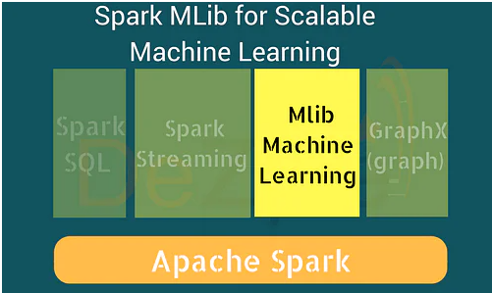
Spark MLlib:
Following are some of the examples to MLlib algorithms, with step by step understanding of ML Pipeline construction and model building :
Classification using Logistic Regression
Classification using Naive Bayes
Generalized Regression
Survival Regression
Decision Trees
Random Forests
Gradient Boosted Trees
Recommendation using Alternating Least Squares (ALS)
Clustering using KMeans
Clustering using Gaussian Mixtures
Topic Modelling using Latent Dirichlet Conditions
Frequent Itemsets
Association Rules
Sequential Pattern Mining

Slide 11
MLlib Utilities
MLlib provides following workflow utilities :
Feature Transformation
ML Pipeline construction
Model Evaluation
Hyper-parameter tuning
Saving and loading of models and pipelines
Distributed Linear Algebra
Statistics

Slide 12
MLlib is one of the four Apache Spark‘s libraries. It is a scalable Machine Learning Library.
Programming
MLlib could be developed using Java (Spark’s APIs).
With latest Spark releases, MLlib is inter-operable with Python’s Numpy libraries and R libraries.
Data Source
Using MLlib, one can access HDFS(Hadoop Data File System) and HBase, in addition to local files. This enables MLlib to be easily plugged into Hadoop workflows.
Performance
Spark’s framework excels at iterative computation. This enables the iterative parts of MLlib algorithms to run fast. And also MLlib contains high quality algorithms for Classification, Regression, Recommendation, Clustering, Topic Modelling, etc.
PySpark has this machine learning API in Python as well. It supports different kind of algorithms, which are mentioned below −
mllib.classification − The spark.mllib package supports various methods for binary classification, multiclass classification and regression analysis. Some of the most popular algorithms in classification are Random Forest, Naive Bayes, Decision Tree, etc.

Slide 13
mllib.clustering − Clustering is an unsupervised learning problem, whereby you aim to group subsets of entities with one another based on some notion of similarity.
mllib.fpm − Frequent pattern matching is mining frequent items, itemsets, subsequences or other substructures that are usually among the first steps to analyze a large-scale dataset. This has been an active research topic in data mining for years.
mllib.linalg − MLlib utilities for linear algebra.
mllib.recommendation − Collaborative filtering is commonly used for recommender systems. These techniques aim to fill in the missing entries of a user item association matrix.
spark.mllib − It ¬currently supports model-based collaborative filtering, in which users and products are described by a small set of latent factors that can be used to predict missing entries. spark.mllib uses the Alternating Least Squares (ALS) algorithm to learn these latent factors.
mllib.regression − Linear regression belongs to the family of regression algorithms. The goal of regression is to find relationships and dependencies between variables. The interface for working with linear regression models and model summaries is similar to the logistic regression case.
There are other algorithms, classes and functions also as a part of the mllib package.

Slide 14
let us understand a demonstration on pyspark.mllib.
Dataset used − test.data
1,1,5.0
1,2,1.0
1,3,5.0
1,4,1.0
2,1,5.0
2,2,1.0
2,3,5.0
2,4,1.0
3,1,1.0
3,2,5.0
3,3,1.0
3,4,5.0
4,1,1.0
4,2,5.0
4,3,1.0
4,4,5.0

Slide 15
--------------------------------------recommend.py----------------------------------------
from __future__ import print_function
from pyspark import SparkContext
from pyspark.mllib.recommendation import ALS, MatrixFactorizationModel, Rating
if __name__ == "__main__":
sc = SparkContext(appName="Pspark mllib Example")
data = sc.textFile("test.data")
ratings = data.map(lambda l: l.split(','))\
.map(lambda l: Rating(int(l[0]), int(l[1]), float(l[2])))
# Build the recommendation model using Alternating Least Squares
rank = 10
numIterations = 10
model = ALS.train(ratings, rank, numIterations)
# Evaluate the model on training data
testdata = ratings.map(lambda p: (p[0], p[1]))
predictions = model.predictAll(testdata).map(lambda r: ((r[0], r[1]), r[2]))
ratesAndPreds = ratings.map(lambda r: ((r[0], r[1]), r[2])).join(predictions)
MSE = ratesAndPreds.map(lambda r: (r[1][0] - r[1][1])**2).mean()

Slide 16
print("Mean Squared Error = " + str(MSE))
# Save and load model
model.save(sc, "target/tmp/myCollaborativeFilter")
sameModel = MatrixFactorizationModel.load(sc, "target/tmp/myCollaborativeFilter")
--------------------------------------recommend.py----------------------------------------
Command − The command will be as follows −
$SPARK_HOME/bin/spark-submit recommend.py
Output − The output of the above command will be −
Mean Squared Error = 1.20536041839e-05

Slide 17
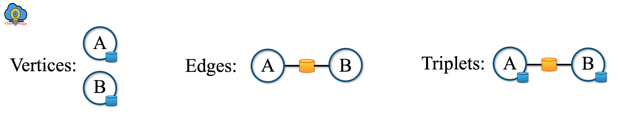
Apache Spark GraphX
What is a Graph?
A Graph is a representation of the directed and undirected graph concept that is taken from mathematics graph theory.
What is Apache Spark GraphX?
Apache Spark GraphX is a distributed graph processing framework that is used to process graphs in parallel. It provides a collection of Graph algorithms and builders which are used to analyze the graph tasks easily. GraphX uses the Spark RDD to provides a new Graph abstraction. There is a property graph that has user-defined objects for each property graph.
Apache Spark GraphX Features
Apache Spark GraphX provides following features.
1. Flexibility
2. Speed
3. Algorithms
Apache Spark GraphX provides the following graph algorithms.
PageRank, Connected Components, Label Propagation, SVD++,Strongly Connected Components, Triangle Count.

Slide 18
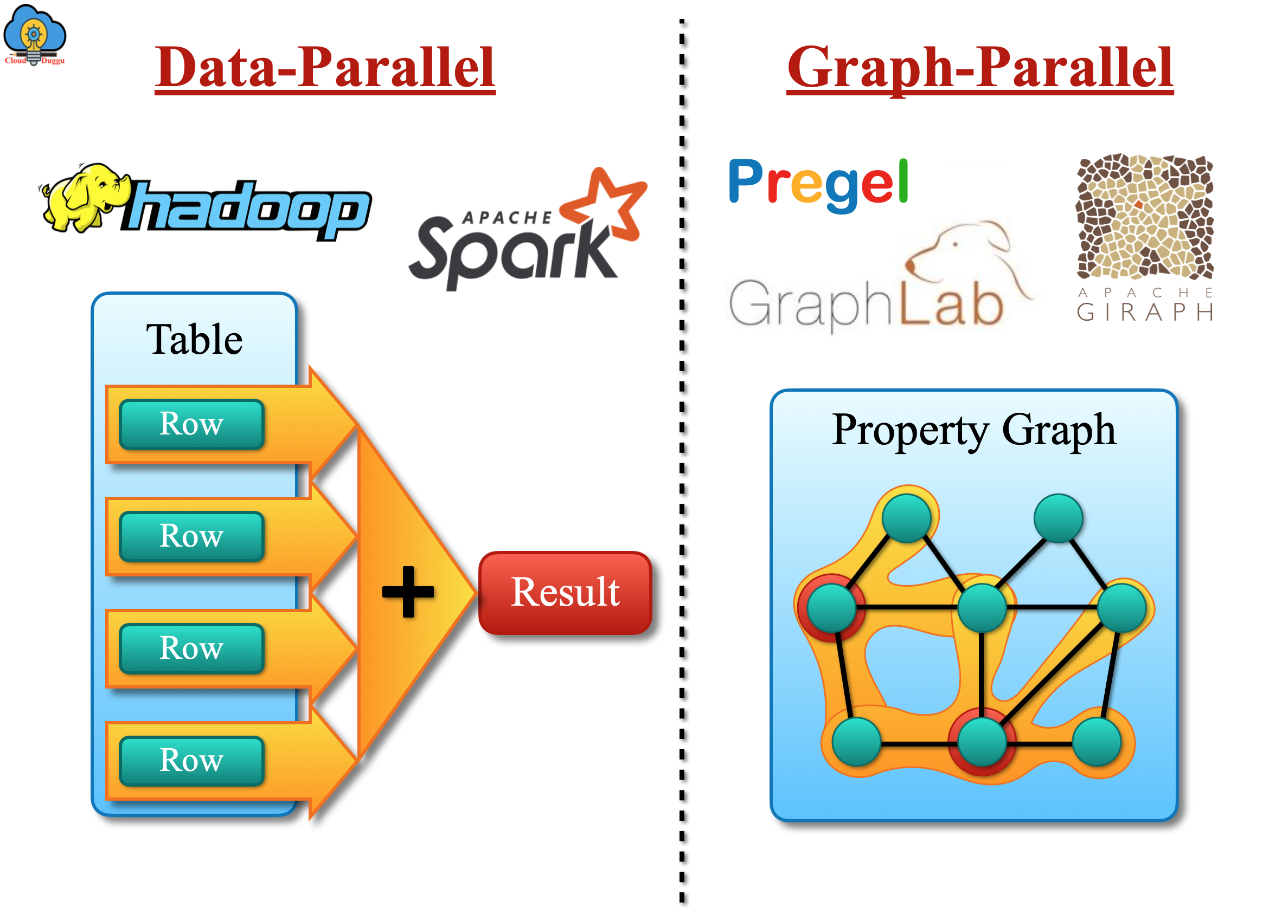
Background on Graph-Parallel Computation
The graph data keeps growing day after day and looking into its importance the new graph processing systems are getting developed. These systems are working on the new technology to perform partition and process graphs distributedly. The Graphics algorithms are getting tested with new systems to provides a faster response compared to the common data processing systems.

Slide 19
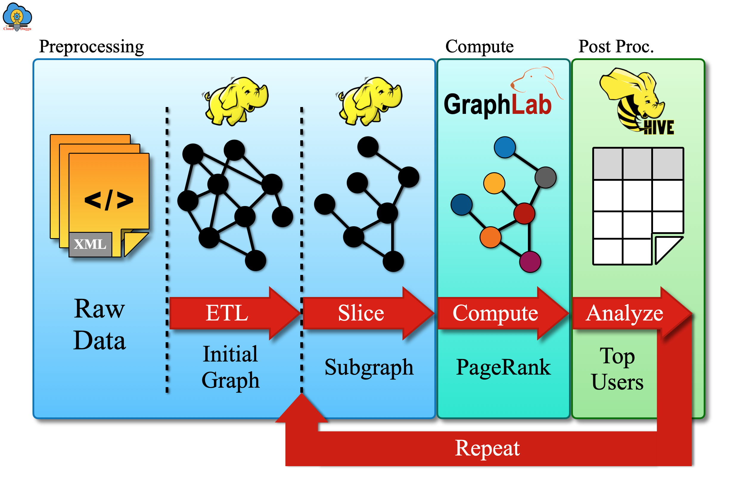
Apache Spark GraphX Project Goal
The existing Graph processing system work on the complicated programming model that leads to heavy data movement and duplications. So to overcome, this issue Apache Spark GraphX project is an ally to provide the data-parallel and graph-parallel processing to a single system with one composable API. Apache Spark GraphX API provides the facility to see data as a collection as well as graphs without any duplication or any data movement.

Slide 20
Graph Algorithms
Apache GraphX provides a set of graph algorithms to simplify analytics tasks. These algorithms are contained in the org.apache.spark.graphx.lib package and can be accessed directly as methods on Graph via GraphOps.
1. PageRank Algorithm
The Graphs PageRank Algorithm estimate the usage of every vertex of the Graph and assume that the representation of the edge from u to v is the description of v's. The best example of PageRank is Twitter users in that if a Twitter user is followed by many others, the user will be ranked highly.
Let us understand the PageRank Algorithm with the help of the Social networking program.
PageRank Program Execution
We have two datasets one is for users and another one is for user’s followers. We will compute the PageRank of each user as follows.
Datasets & Program Details
Datasets for this program are present under SPARK_HOME directory.
graphx/data/followers.txt
graphx/data/users.txt
Location of PageRankExample.scala program is mentioned below.
/home/cloudduggu/spark/examples/src/main/scala/org/apache/spark/examples/graphx/PageRankExample.scala
Run PageRankExample.scala program from SPARK_HOME.
./bin/run-example org.apache.spark.examples.graphx.PageRankExample

Slide 21
import org.apache.spark.graphx.GraphLoader
import org.apache.spark.sql.SparkSession
object PageRankExample {
def main(args: Array[String]): Unit = {
val spark = SparkSession.builder
.appName(s"${this.getClass.getSimpleName}")
.getOrCreate()
val sc = spark.sparkContext
val graph = GraphLoader.edgeListFile(sc, "data/graphx/followers.txt")
val ranks = graph.pageRank(0.0001).vertices
val users = sc.textFile("data/graphx/users.txt").map { line =>
val fields = line.split(",")
(fields(0).toLong, fields(1))
}
val ranksByUsername = users.join(ranks).map {
case (id, (username, rank)) => (username, rank)
}
println(ranksByUsername.collect().mkString("\n"))
spark.stop()
}
}

Slide 22

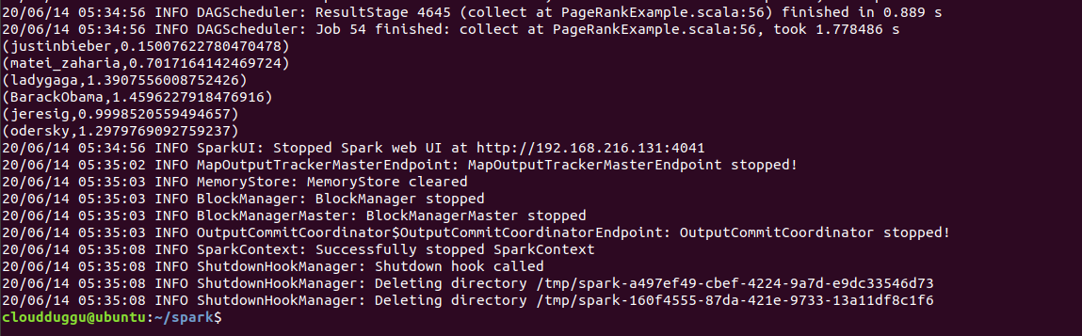

Slide 23
2. Connected Components Algorithm
In the connected components algorithm, there is a subgraph in which each vertex is accessible to each other vertex by following edges. In this algorithm, every connected component of the graph is tagged with an ID from its lower vertex.
Connected Components Program Execution
We have two datasets one is for users and another one is for user’s followers. We will compute the PageRank of each user as follows.
Datasets & Program Details
Datasets for this program are present under SPARK_HOME directory.
graphx/data/followers.txt
graphx/data/users.txt
Location of ConnectedComponentsExample.scala program is mentioned below.
/home/cloudduggu/spark/examples/src/main/scala/org/apache/spark/examples/graphx/ConnectedComponentsExample.scala
Run ConnectedComponentsExample.scala program from SPARK_HOME.
./bin/run-example org.apache.spark.examples.graphx.ConnectedComponentsExample
Let us understand code line by line and then we will execute it on terminal.

Slide 24
import org.apache.spark.graphx.GraphLoader
import org.apache.spark.sql.SparkSession
object ConnectedComponentsExample {
def main(args: Array[String]): Unit = {
val spark = SparkSession.builder
.appName(s"${this.getClass.getSimpleName}")
.getOrCreate()
val sc = spark.sparkContext
val graph = GraphLoader.edgeListFile(sc, "data/graphx/followers.txt")
val cc = graph.connectedComponents().vertices
val users = sc.textFile("data/graphx/users.txt").map { line =>
val fields = line.split(",")
(fields(0).toLong, fields(1))
}
val ccByUsername = users.join(cc).map {
case (id, (username, cc)) => (username, cc)
}
println(ccByUsername.collect().mkString("\n"))
spark.stop()
}
}

Slide 25

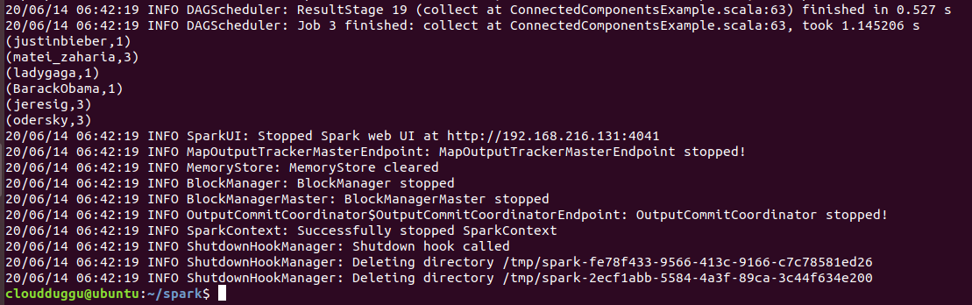

Slide 26



